Slide 1

"Life's a puzzle, and I love solving it both in code and on my plate."
Goals
Aim to become a lead software engineer and work on cutting-edge projects that make a positive impact.
Would love to visit the French restaurant more often and become a regular patron. So with more visits, I can explore a wider range of dishes on the menu.
Frustrations
I found the French menu a bit intimidating, as I doesn't speak French. I wished for clearer explanations of the dishes in English.
As a vegetarian, I was slightly disappointed by the limited vegetarian options on the menu
Emily Cooper
Emily is a 23 year old software engineer living in Boston,works for a tech company that specializes in creating innovative mobile apps. Emily is known for her cheerful disposition and her love for exploring new cuisines.She loves French food firsthand & to experience the culture, and maybe even learn to speak French.
Age: 23
Education : Bachelor of Software Engineering, MIT, USA
Hometown: Boston,USA
Family: 1 Dog
Occupation: Data Analyst

Slide 2
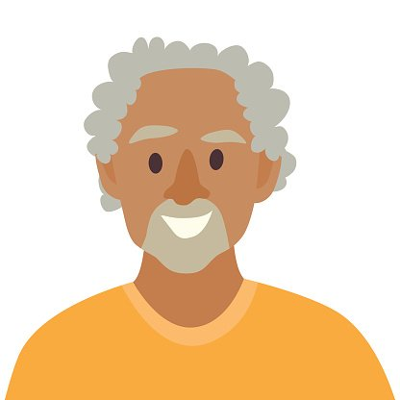
"Embracing the journey of life, each day a new chapter, and the pages filled with memories and wisdom."
Goals
Primary goal is to maintain good health in retirement years. I pay close attention to dietary choices, preferred balanced and nutritious meals.
Create special moments and memories when dining out with loved ones, invite friends and family to join for meals at favorite restaurants.
Stay active & healthy.
Frustrations
Face mobility challenges
Can't visit restaurants with difficult access or multiple stairs.
Modern restaurants are noisy, with loud music and conversations
To find healthy and nutritious options that align with dietary needs.
Robert Anderson
Age: 72
Education : Masters in History,Northeastern University.
Hometown: Brooklin,USA
Family: Wife
Occupation: Retired
Robert is a 72-year-old retired person who spent his working years as a high school teacher. He is now enjoying his well-deserved retirement in a cozy suburban home with his wife. His Passion for literature and teaching inspired his love for sharing meals and exploring diverse cuisines in retirement, making dining out a cherished part of his life.

